Slide 1
Skin Walker
Team Rocket Presents
A Sprite down the Memory Lane

Slide 2
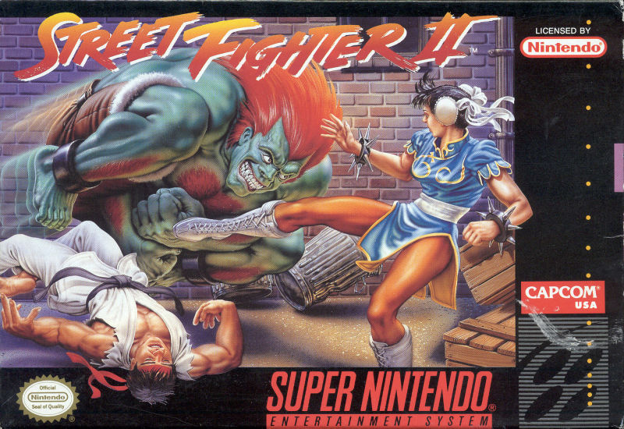
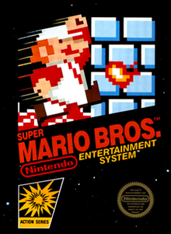
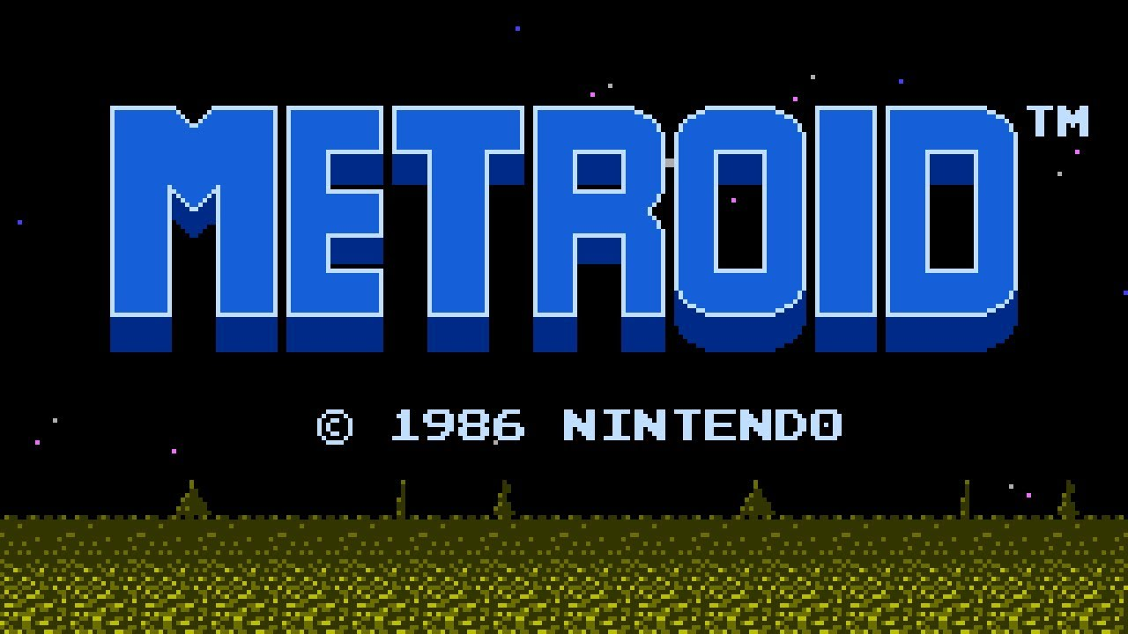
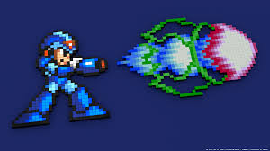
Remember the first game you loved? Was it:::
Commercial Game Originated from Platformers.

Slide 3
Key points
Nostalgia
Simplicity
Motivation

Slide 4
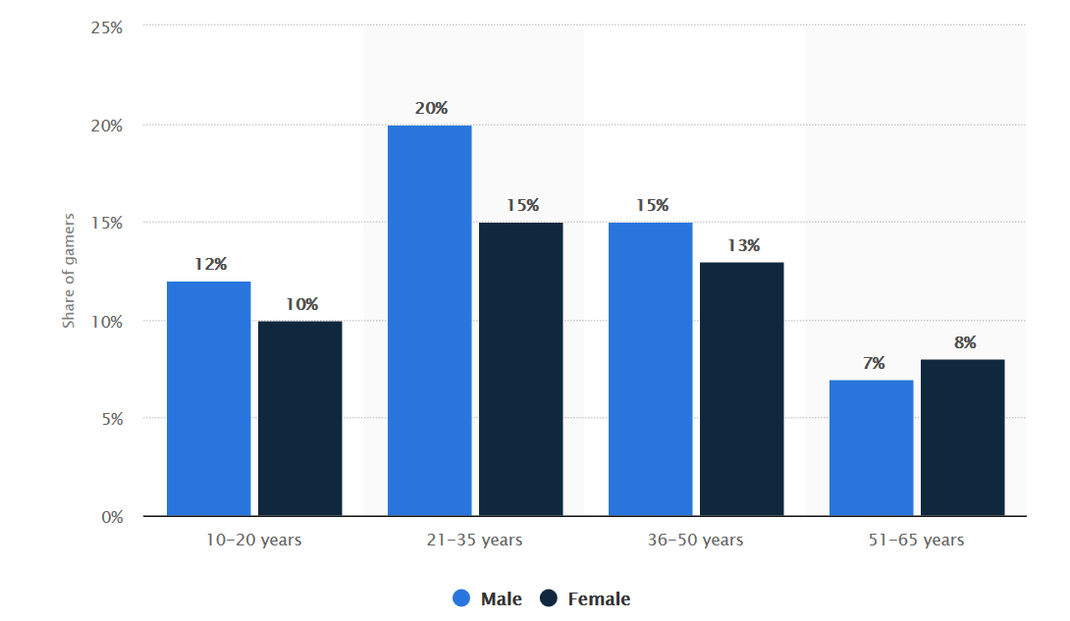
Average age of gamers
What the Graph tells Us:
Average gamer = 20-35 years old
Less games for 10-20 years old.

Slide 5
Expected Audience And market
Gamers From old times
Sick of new and repeated formulas and want a new type of game
Learners and enthusiasts

Slide 6
Target Type
Hard Core gamers
Casual Gamers
Somewhere In between ☺

Slide 7
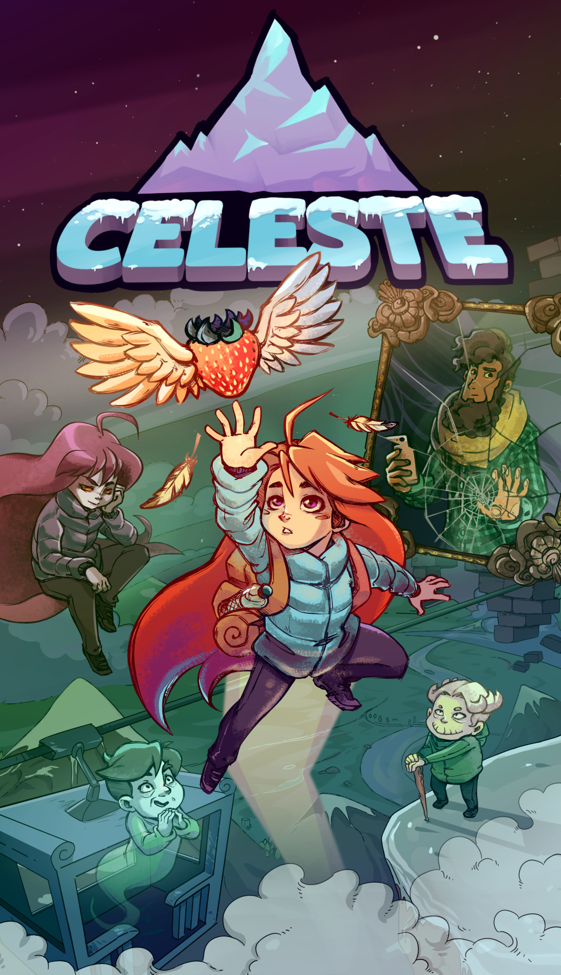
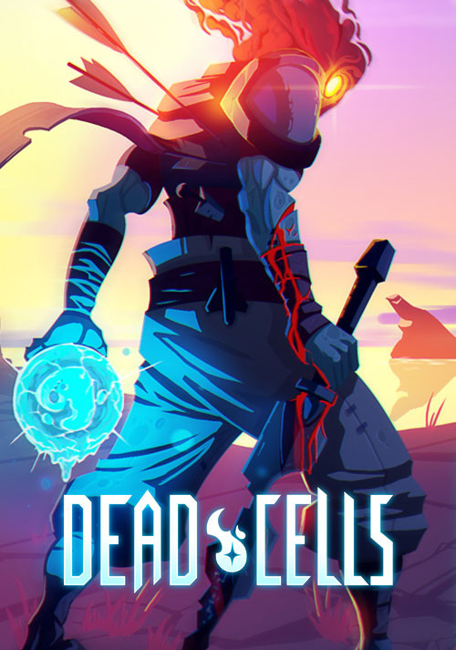
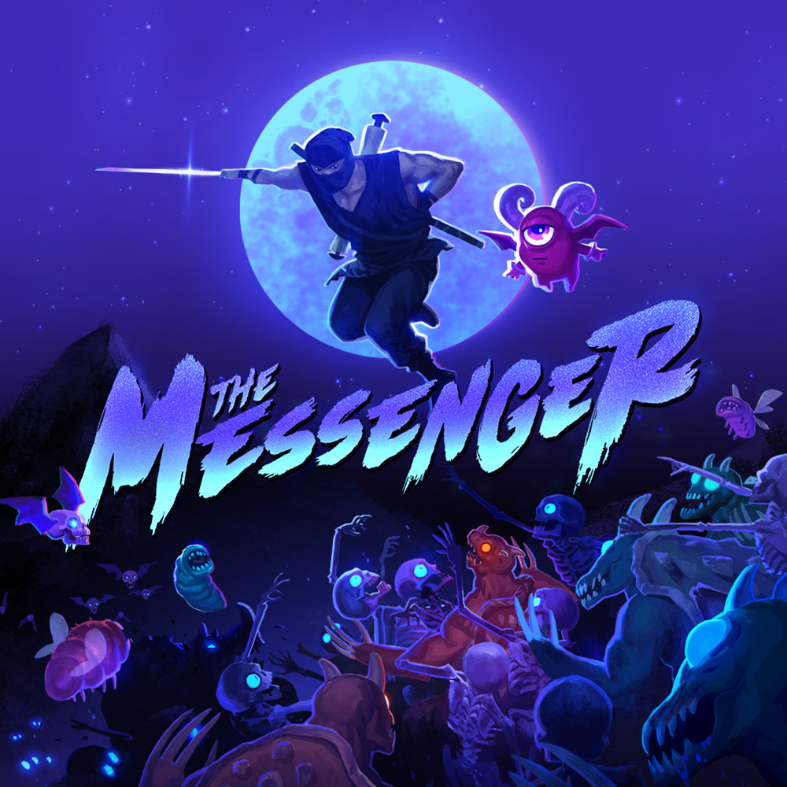
Lately Retro Style games
Best Independent game(2018) : Celeste
Games for Impact(2018) : Celeste
Best Indie Game Award (2018) : Dead Cells
Best Debut Indie Game(2018) : The Messenger

Slide 8
gameplay
Transformation
Action platformer
Puzzle

Slide 9
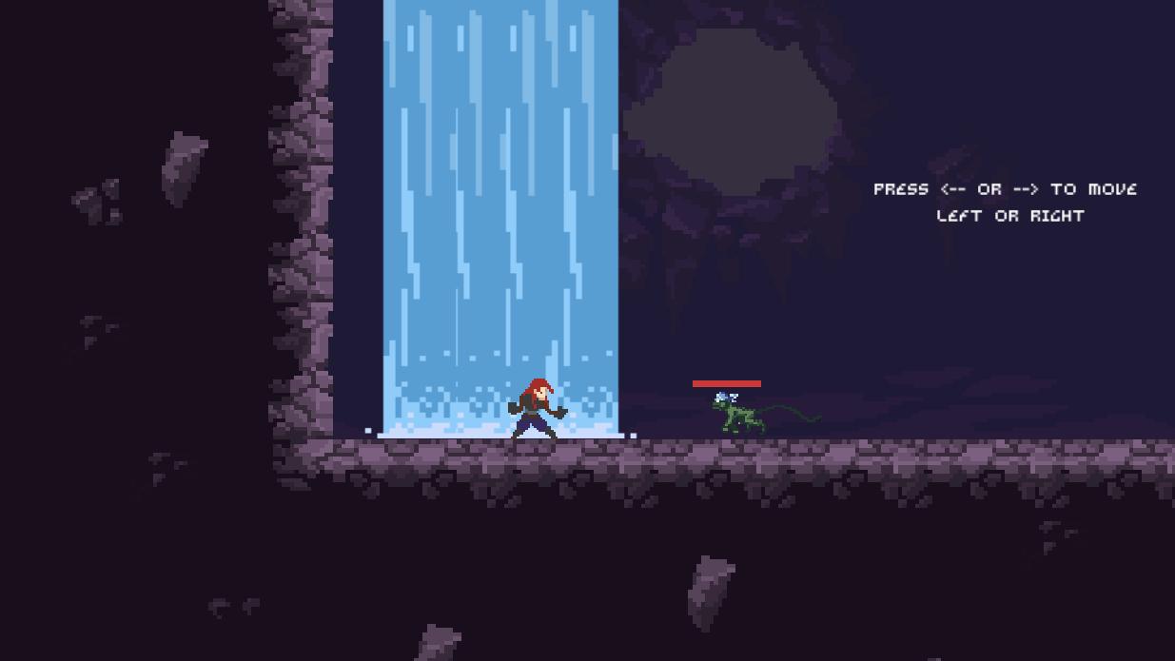
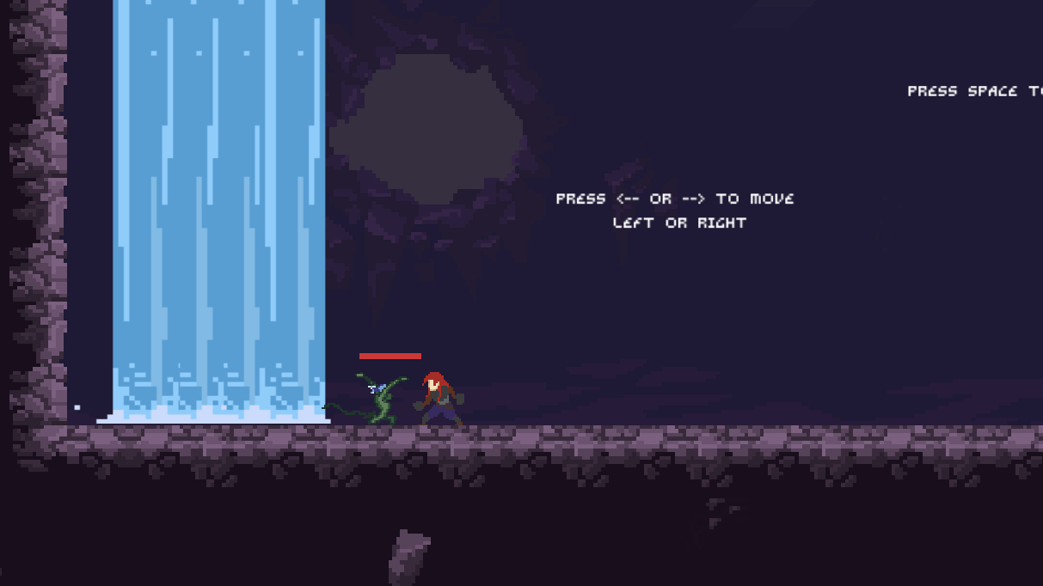
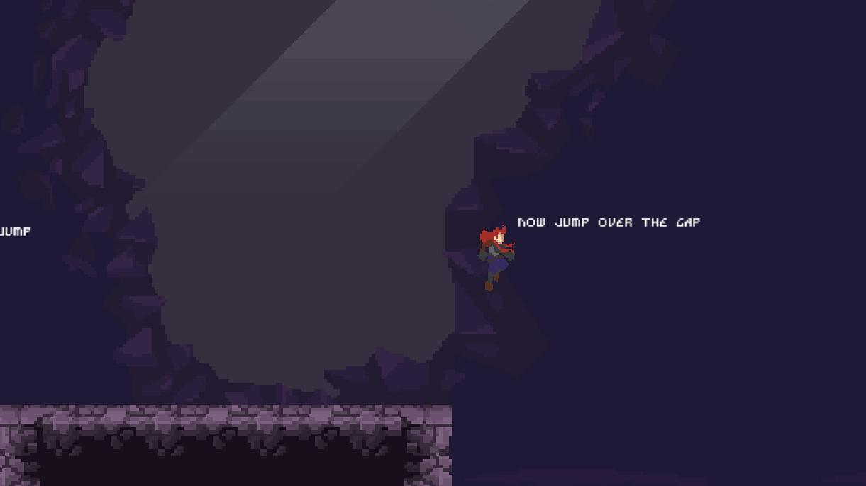
Sample Images

Slide 10

Future
More Levels
More Terrains
Bosses
More Transformation
Story !!!

Slide 11
Contact Us:
Maharshi Bhusal
Dinesh Devkota
Sujit Silwal
Drop by Discord to Help:
https://discord.gg/FcRgAwT

